Slide 1
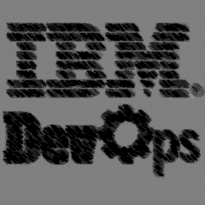

Modern Application Development on z/OS Explore the possibilities with IBM’s zDevOps solution
Nelson Lopez
Z DevOps Transformation Specialist (Americas)
Global zDevOps Acceleration Team (DAT)
Nelson.lopez1@ibm.com

Slide 2
Topics
IBM’s Core DevOps Capabilities
Architecture
IBM Dependency Based Build (DBB) & CI
Urban Code Deploy Overview & CD
Scripting with Groovy
Getting started – workflows
Migration, Developer Workflow, Pipelines
Duration ~ 30mins

Slide 3

The 6 core DevOps capabilities
Continuous Integration
Discover and unleash IBM Z through API’s
Improve speed and quality
Optimize Cost and Skills
{...}
$
Automated Testing (zUnit..)
Bring your own IDE
(IBM IDz, VS Code …)
Enterprise class discovery and intelligence
(ADDI)
Enterprise wide standardization with an open pipeline
(Jenkins, Azure …)
Dependency Based Build
(DBB)
On demand development and test environments
(zD&T)

Slide 4
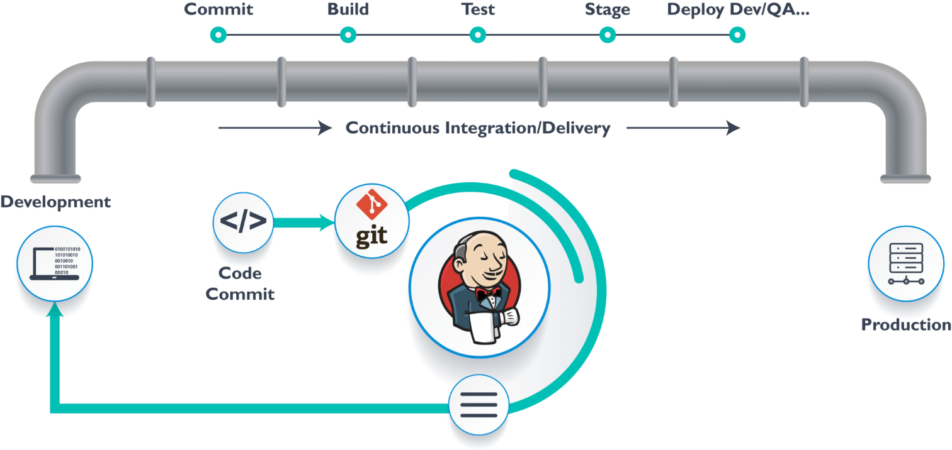
Continuous Integration (CI) and Continuous Delivery (CD) Pipeline: processes and practices that enable application development teams to deliver changes more reliably and regularly
CI
how developers merge code into a shared git repository to perform automated builds and tests
CD
a strategy in which software is ready for release at any time
“Always Buildable & Deployable”

Slide 5






A closer look z/OS DevOps lifecycle
Analysis & Planning
Development Phase
Continuous Deployment
Developer
Sprints
User Builds
Ops
. Automated Impact Analysis
. Code Checkout & packaging
. Automated Test environment buildout
Branch
Code
Commit
IDz
zUnit
Report
Build
QA …
PROD
Master
Git
Clones
Dev Repo
Pull Requests
zD&T
DBB
zUnit
Git Server
Orchestrator
Deployment Server
Features
Continuous Integration
Team Build
Team
Repo
Admin
Lead
SIT
Report
Build`
Code Review
Approve
Merge
Stage
Deploy
Artifacts
Repo
DBB
zD&T
zUnit
Continuous Delivery

Slide 6

Some Git Concepts

Slide 7
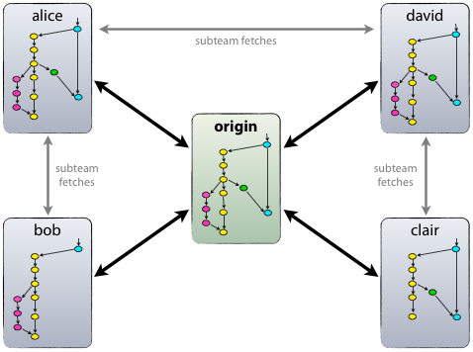
What is Git
A distributed version control system
Runs on z/OS, Linux, Windows, Mac
The standard for modern development
Integrates into all modern DevOps Tools
Open Source, community supported
Can purchase Rocket Git support from IBM
Git Overview: https://www.atlassian.com/git/tutorials/why-git
Git Best Practices: https://sethrobertson.github.io/GitBestPractices/
Notes:
DBB comes with Rocket Git•Rocket
Git is Open Source Software without support
Please recommend purchase of Rocket Git S&S part number to you client (in addition to the standard support coming with DBB S&S) :
IBM Elite Support for Rocket Git for zOS(5737-J47).•1 P/N D226QLL for each Authorized User•You can recommend this regardless of the way the customer “purchases” DBB•Purchase licenses for the number of developers performing builds with DBB

Slide 8
Git manages code in repositories (repos)
Developers clone repo(s) on their local PC
Developers create branches to work in isolation
Developers save changes using commit and push
Developers open Pull Requests (GitHub) to merge their branch which initiates a pipeline build to start the integration process (CI)

Slide 9
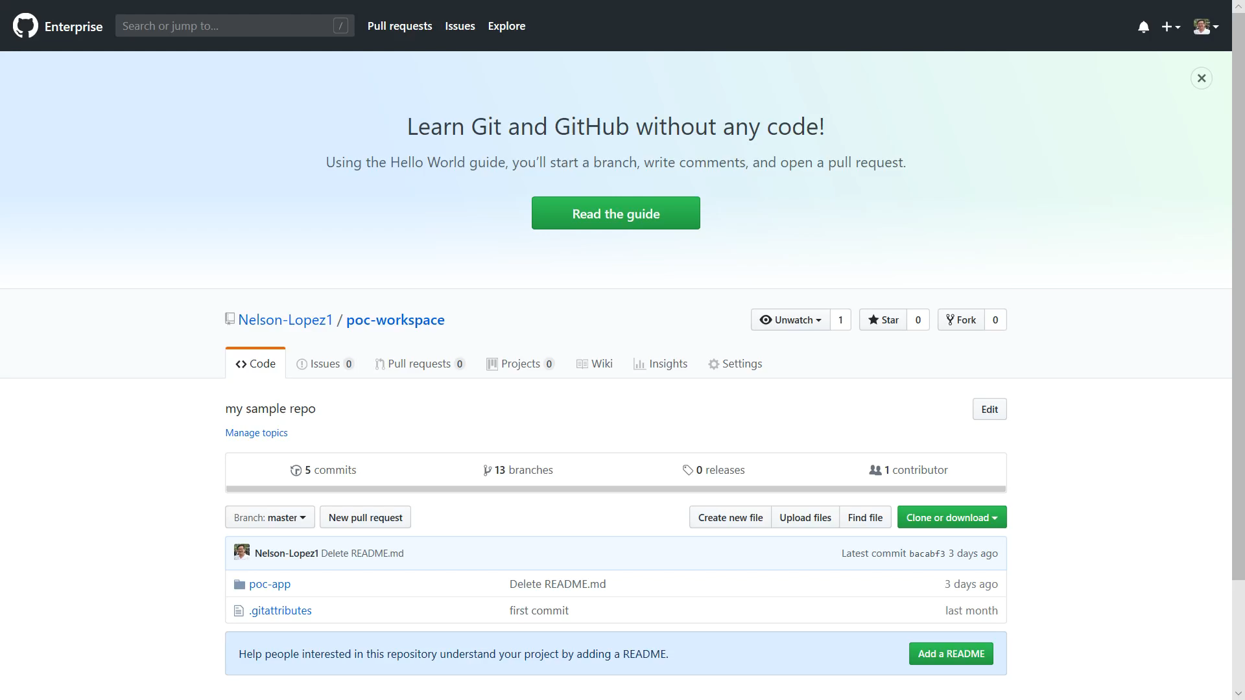
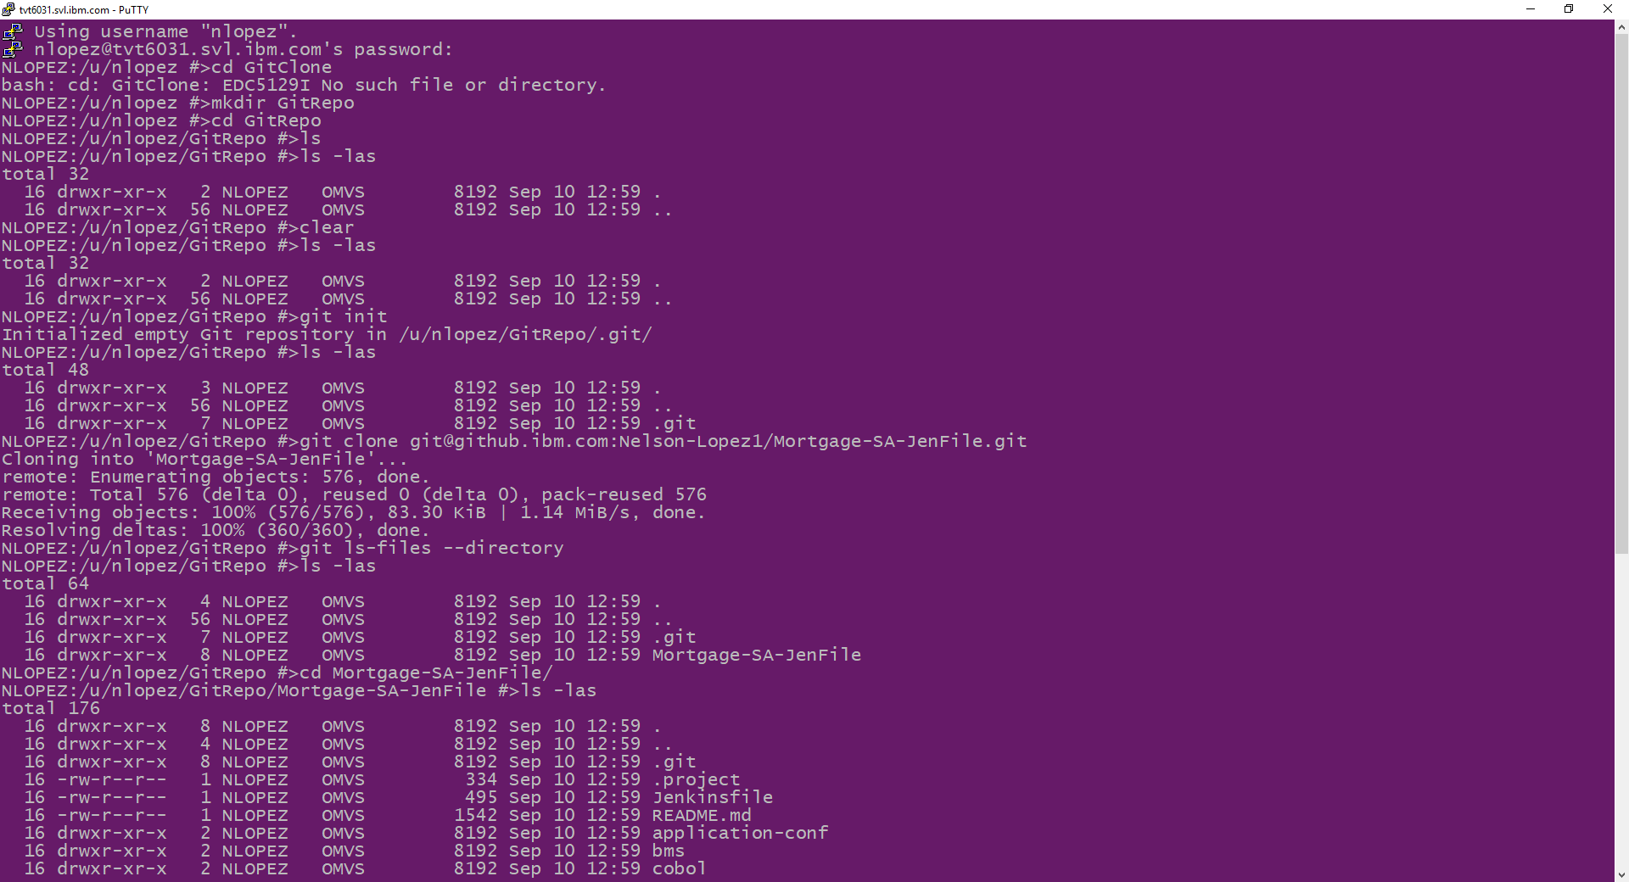
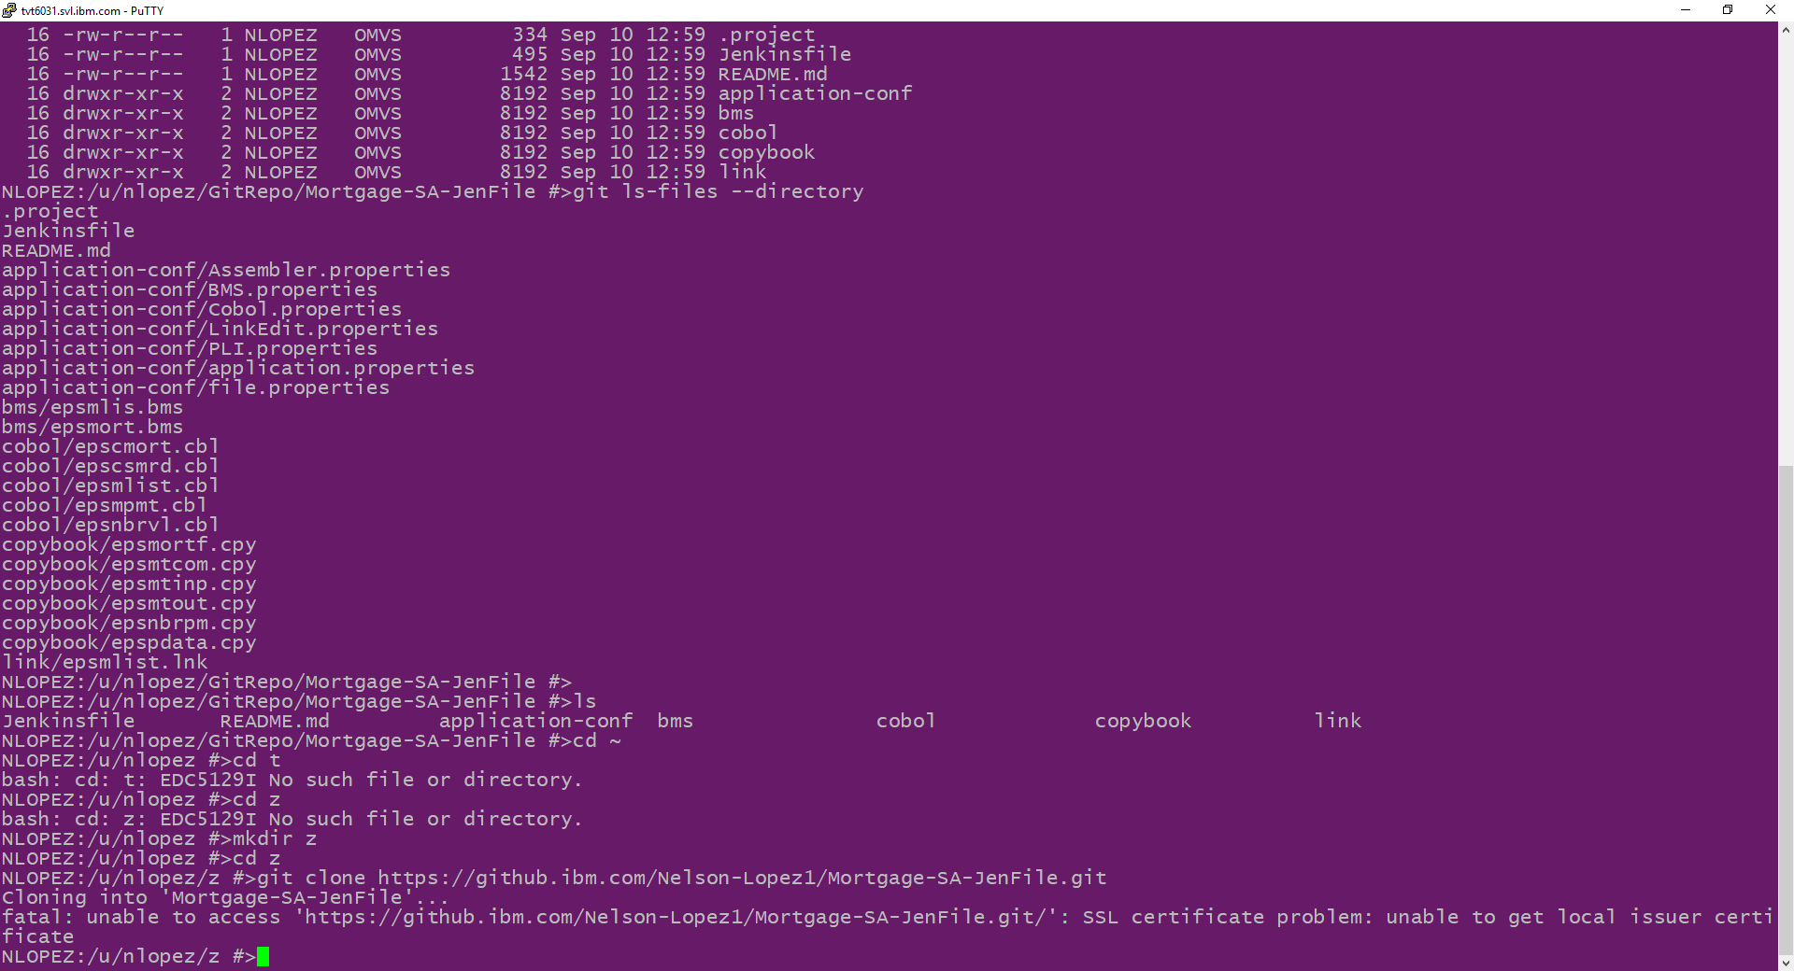
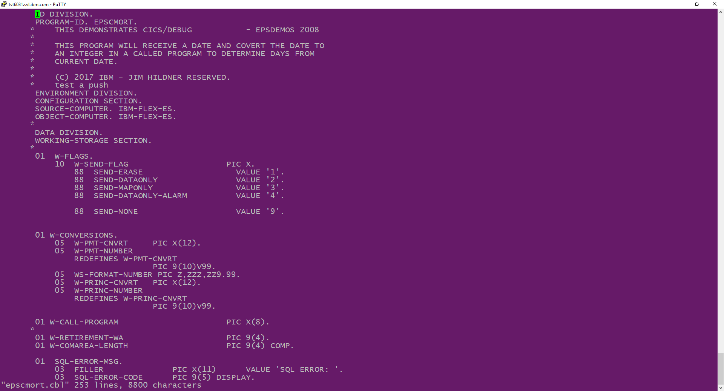
Example Git Clone on z/OS
git clone your-remote-repo
Notes:
Run the sample clone mp4 on USS

Slide 10
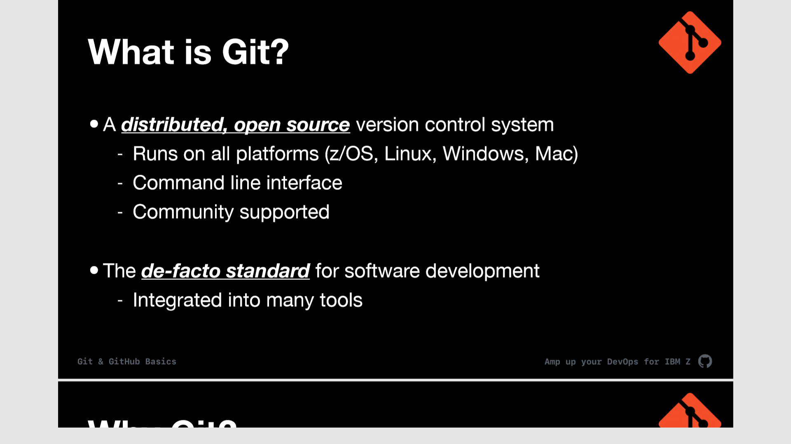
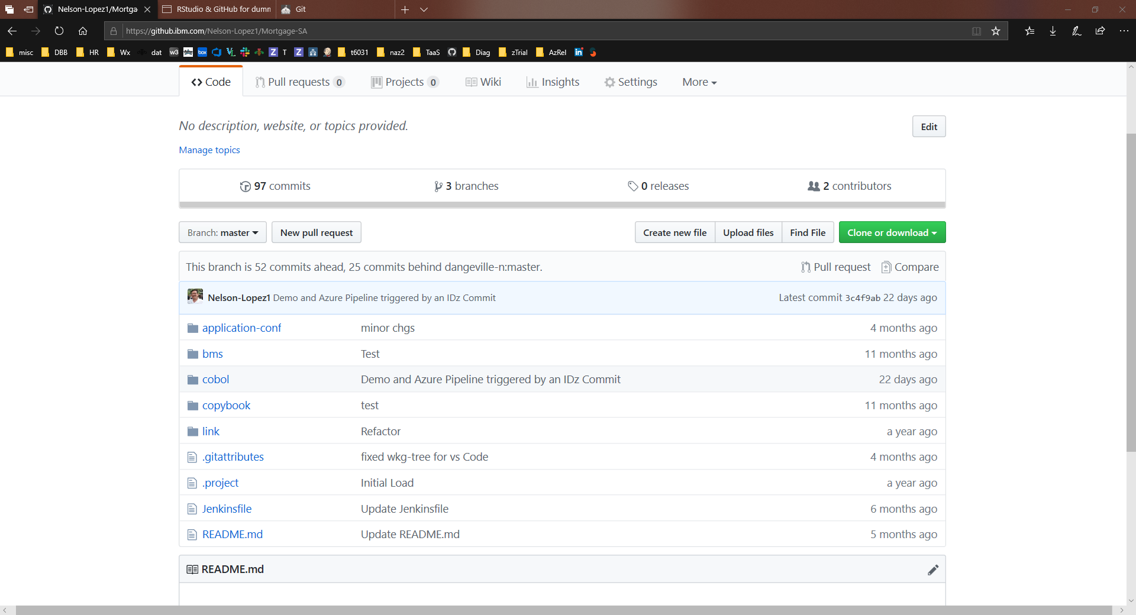
What's in your Repo ?
Anything needed to build, test and deploy an application
Source code
Copy books
JCL
Test cases
BMS maps
Link Edit Cards
Rexx
Documents
Build and Configuration Properties
…..

Slide 11
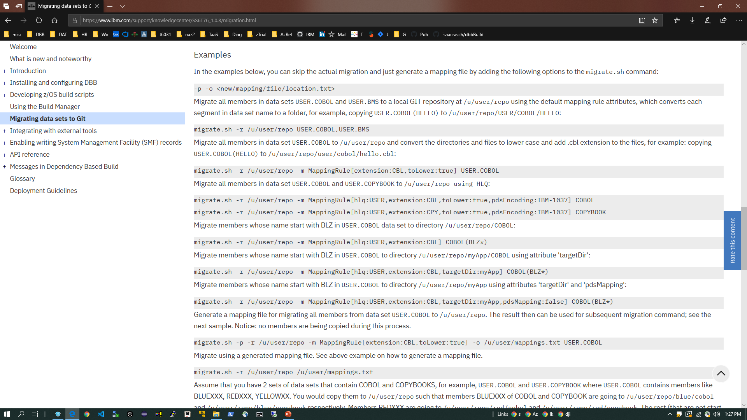
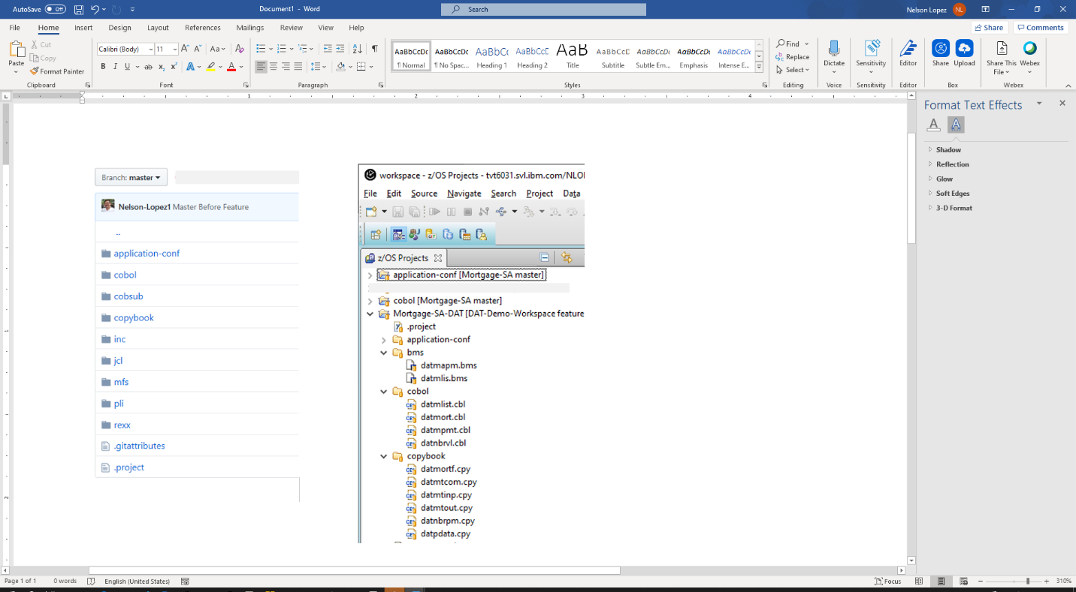
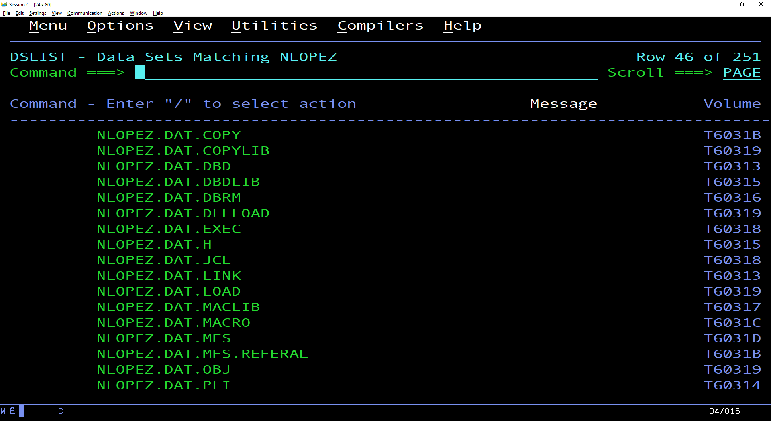
Getting to Git - DBB’s Migrate Tool
REF: https://www.ibm.com/support/knowledgecenter/SS6T76_1.0.8/migration.html
Migrate PDS to Git
Notes:
This is an example of how to migrate a PDS source library to Git
The DBB Toolkit provide a migrate utility (more on that in Day 3)

Slide 12
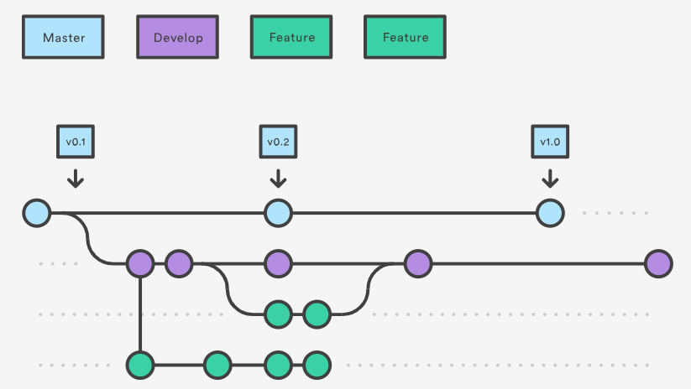
Git Branching & Workflow
Master – The production “gold” copy “Always Deployable” and locked down by Admins
Develop – A ‘team’ branch for integrated builds and tests
Feature – Developer’s branch for isolated Builds and Tests
TIME
Supporting Agile workflows
Notes:
https://www.atlassian.com/git/tutorials/comparing-workflows/gitflow-workflow
Sample Multi Repo Clone
$ mkdir multirepository-cache.git
$ cd multirepository-cache.git
$ git init --bare
$ git remote add parent https://github.com/jenkinsci/git-plugin
$ git remote add child-1 https://github.com/jenkinsci/git-client-plugin
$ git remote add child-2 https://github.com/jenkinsci/platformlabeler-plugin
$ git fetch --all

Slide 13
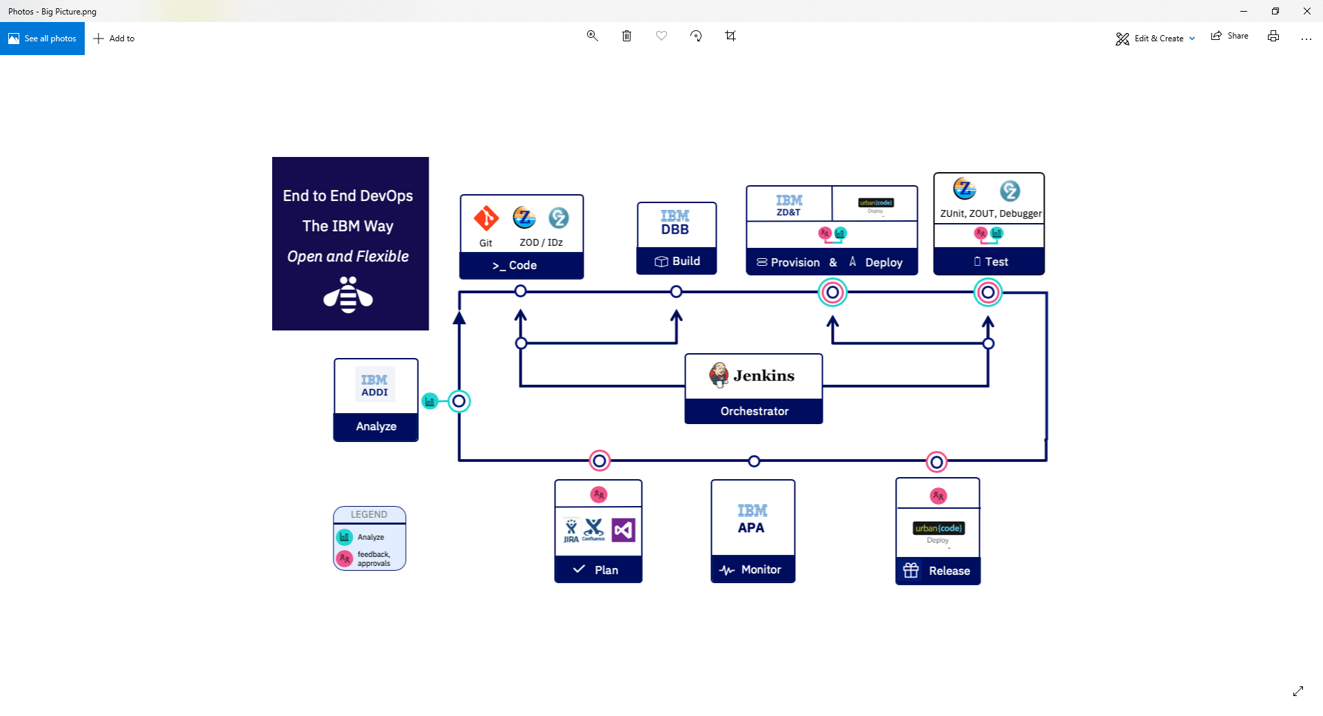
IBM’s Dependency Based Build (DBB)

Slide 14
DBB is a modern mainframe Build tool (compile, link…)
No need for JCL, TSO/ISPF, SDSF, PDS…
Integrates with Jenkins, Azure, Eclipse IDE’s, Git …
Empowering next-Gen Dev’s with “familiar” tooling

Slide 15





DBB Sample Architecture
Jenkins
Azure
Bamboo
Team City…
DBB WebApp
Dependency Metadata
Build Results History
3- Start
Pipeline
Orchestrator
z/OS
DB
Any Git Server
DBB Java Toolkit
2- Pull Request
Master Repository
Agent
CLONE to Z
MVS Java API’s
PDS
Local
repo
Groovy Build scripts
Compile
&
link
Scan, impact analysis, copy to PDS, compile, create artifacts, & report
1- Push
Run Groovy build script
Return status and Logs
Local Repo
USS
MVS
Desktop IDz
Notes:
FYI – IBM Offers Elite Support for Rocket Git for zOS (part # D226Qll) contact your sales rep for details

Slide 16
DBB Starter Kit – aka zAppBuild
Groovy sample scripts – community supported
Generic and customizable
Supports all z/OS application builds
accelerates your adoption of zDevOps
https://github.com/IBM/dbb-zappbuild
Notes:
Show the zAppBuld READ.ME

Slide 17


DBB tracks dependencies between programs and their copybooks
Copybook1
PGM-A
Copybook2
PGM-B
Copybook3
PGM-C
Static Link
“Only build what you changed”

Slide 18
zAppBuild Build Actions
Impact – Only build what you changed
Full – everything in your repo
ScanOnly – Initialize DBB database
Single Program - As with IDz’s ‘User Build’
List of Programs - For special purposes

Slide 19
Impact mode builds only program(s) that have changed since the last successful build or the initial state
Initial State
scanOnly
Impact
build
Impact
build
Impact
build
REPO
pgm-a
pgm-b
pgm-c
pgm-d
…
pgm-x
pgm-a
pgm-b
pgm-d
pgm-x
commit
commit
commit
Notes:
Impact build is a way of building only what has changed since the last successful build.
The diagram show a sample Repo with several pgms
And a timeline marking the commit points of various changes.
And the execution of an Impact build to process just the changes within a commit.

Slide 20
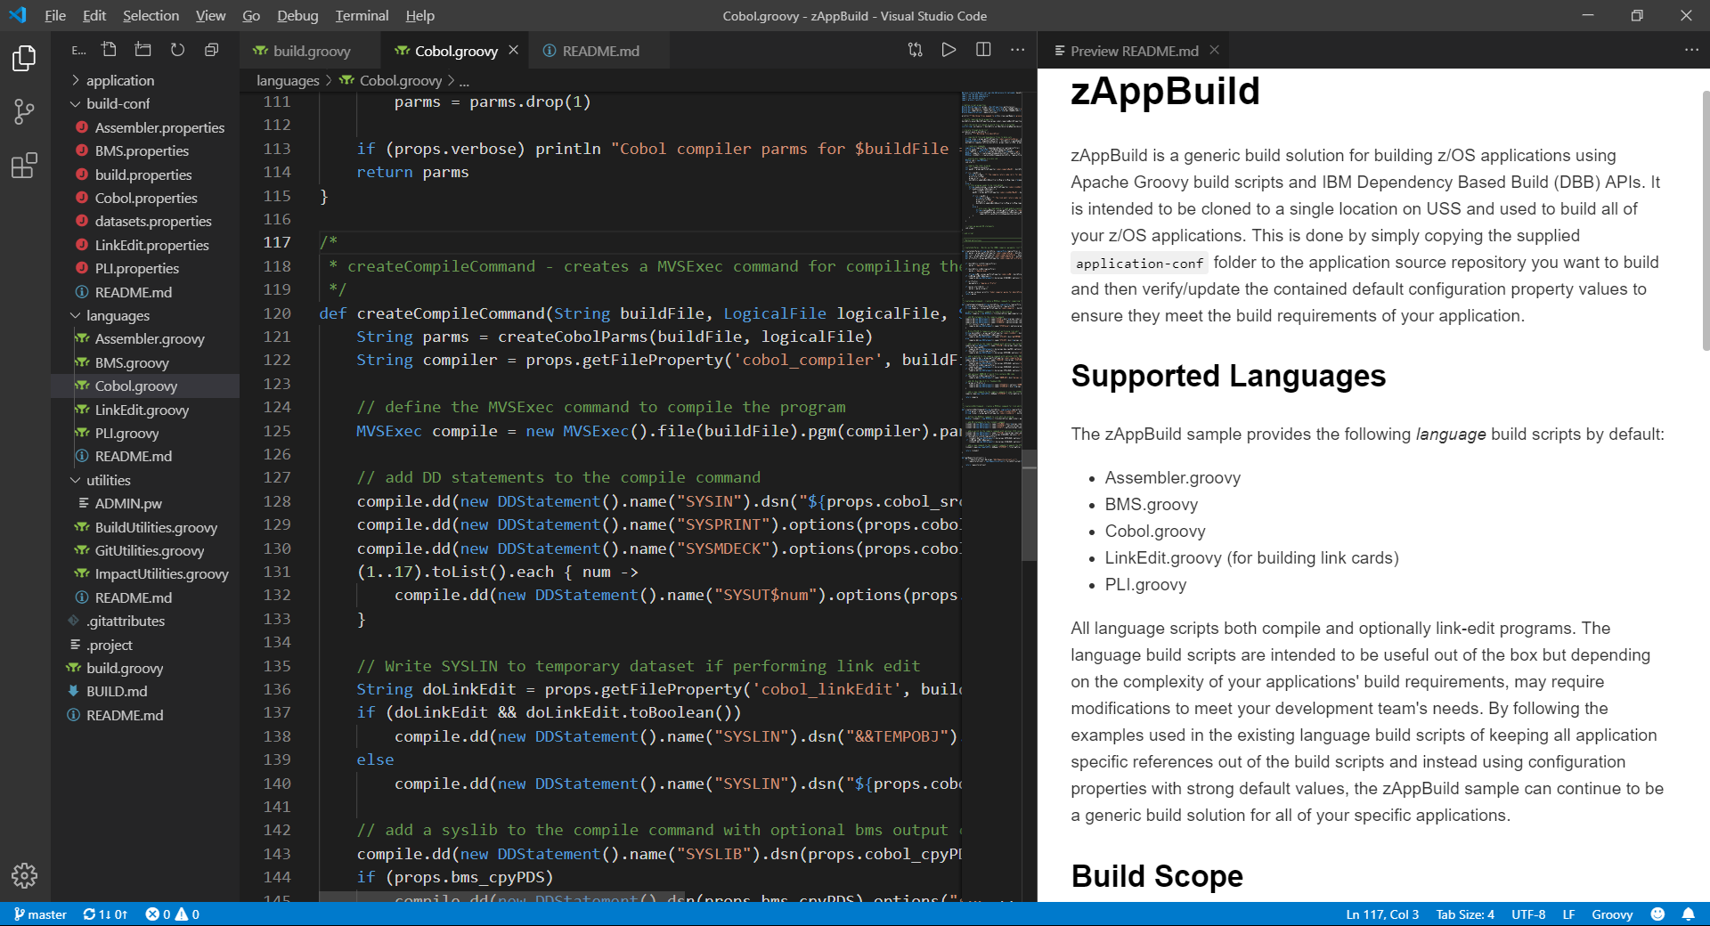
JCL vs Groovy+DBB APIs
import com.ibm.dbb.build.*
println("Copying source from zFS to PDS . . .")
def copy = new CopyToPDS().file(new File("/u/usr1/build/helloworld.cbl"))
.dataset("USR1.BUILD.COBOL").member("HELLO")
copy.execute()
println("Compiling . . .")
def tempOps = “tracks space(5,5) unit(vio) blksize(80) lrecl(80) recfm(f,b) new"
def compile = new MVSExec().pgm("IGYCRCTL").parm("LIB")
compile.dd(new DDStatement().name("TASKLIB").dsn("IGY.SIGYCOMP").options("shr"))
compile.dd(new DDStatement().name("SYSIN").dsn("USR1.BUILD.COBOL(HELLO)")
.options("shr"))
compile.dd(new DDStatement().name("SYSLIN").dsn("USR1.BUILD.OBJ(HELLO)")
.options("shr"))
compile.dd(new DDStatement().name("SYSPRINT").options(tempOps))
compile.dd(new DDStatement().name("SYSUT1").options(tempOps))
compile.dd(new DDStatement().name("SYSUT2").options(tempOps))
compile.dd(new DDStatement().name("SYSUT3").options(tempOps))
compile.dd(new DDStatement().name("SYSUT4").options(tempOps))
compile.dd(new DDStatement().name("SYSUT5").options(tempOps))
compile.dd(new DDStatement().name("SYSUT6").options(tempOps))
compile.dd(new DDStatement().name("SYSUT7").options(tempOps))
compile.copy(new CopyToHFS().ddName("SYSPRINT")
.file(new File("/u/usr1/build/helloworld.log")))
def rc = compile.execute()
if (rc > 4)
println("Compile failed! RC=$rc")
else
println("Compile successful! RC=$rc")
//COBOL EXEC PGM=IGYCRCTL,REGION=0M,
// PARM='LIB'
//*
//STEPLIB DD DISP=SHR,DSN=IGY.SIGYCOMP
//*
//SYSIN DD DISP=SHR,DSN=USER1.BUILD.COBOL(HELLO)
//SYSLIN DD DISP=SHR,DSN=USER1.BUILD.OBJ(HELLO)
//SYSPRINT DD SYSOUT=*
//SYSUT1 DD DISP=(NEW,PASS),SPACE=(TRK,(5,5)),UNIT=VIO,
// BLKSIZE=80,LRECL=80,RECFM=FB
//SYSUT2 DD DISP=(NEW,PASS),SPACE=(TRK,(5,5)),UNIT=VIO,
// BLKSIZE=80,LRECL=80,RECFM=FB
//SYSUT3 DD DISP=(NEW,PASS),SPACE=(TRK,(5,5)),UNIT=VIO,
// BLKSIZE=80,LRECL=80,RECFM=FB
//SYSUT4 DD DISP=(NEW,PASS),SPACE=(TRK,(5,5)),UNIT=VIO,
// BLKSIZE=80,LRECL=80,RECFM=FB
//SYSUT5 DD DISP=(NEW,PASS),SPACE=(TRK,(5,5)),UNIT=VIO,
// BLKSIZE=80,LRECL=80,RECFM=FB
//SYSUT6 DD DISP=(NEW,PASS),SPACE=(TRK,(5,5)),UNIT=VIO,
// BLKSIZE=80,LRECL=80,RECFM=FB
//SYSUT7 DD DISP=(NEW,PASS),SPACE=(TRK,(5,5)),UNIT=VIO,
// BLKSIZE=80,LRECL=80,RECFM=FB

Slide 21
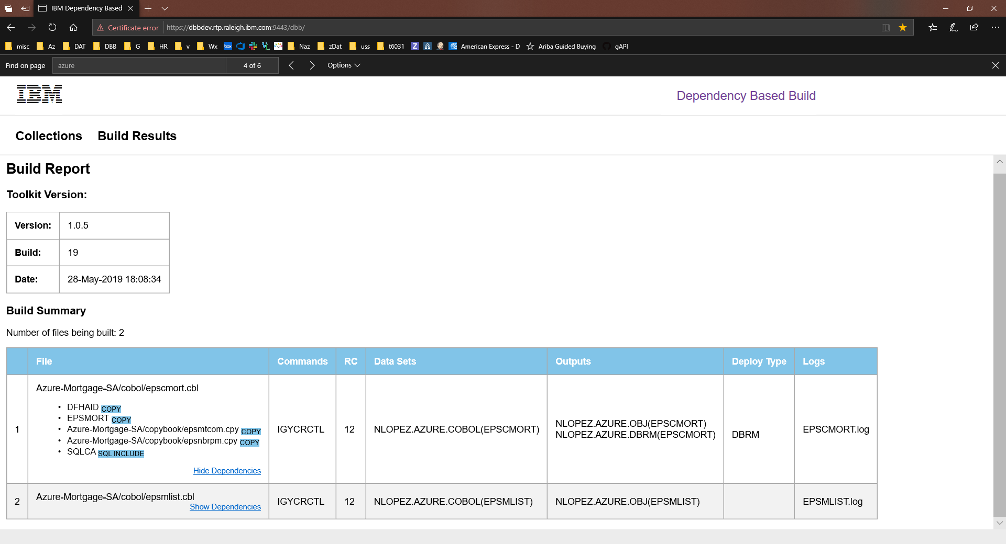
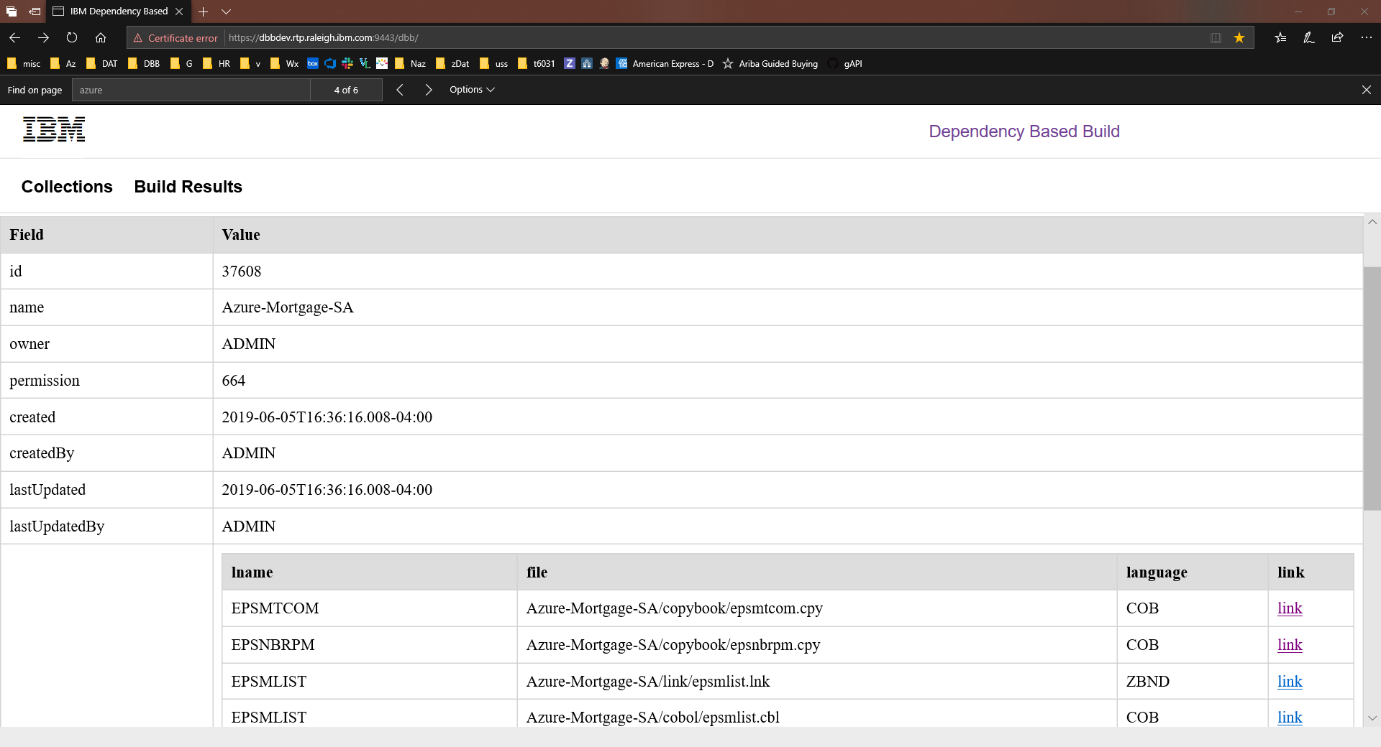
DBB Web Application & Database
Dependency information by App
Build result reports
REST APIs access

Slide 22
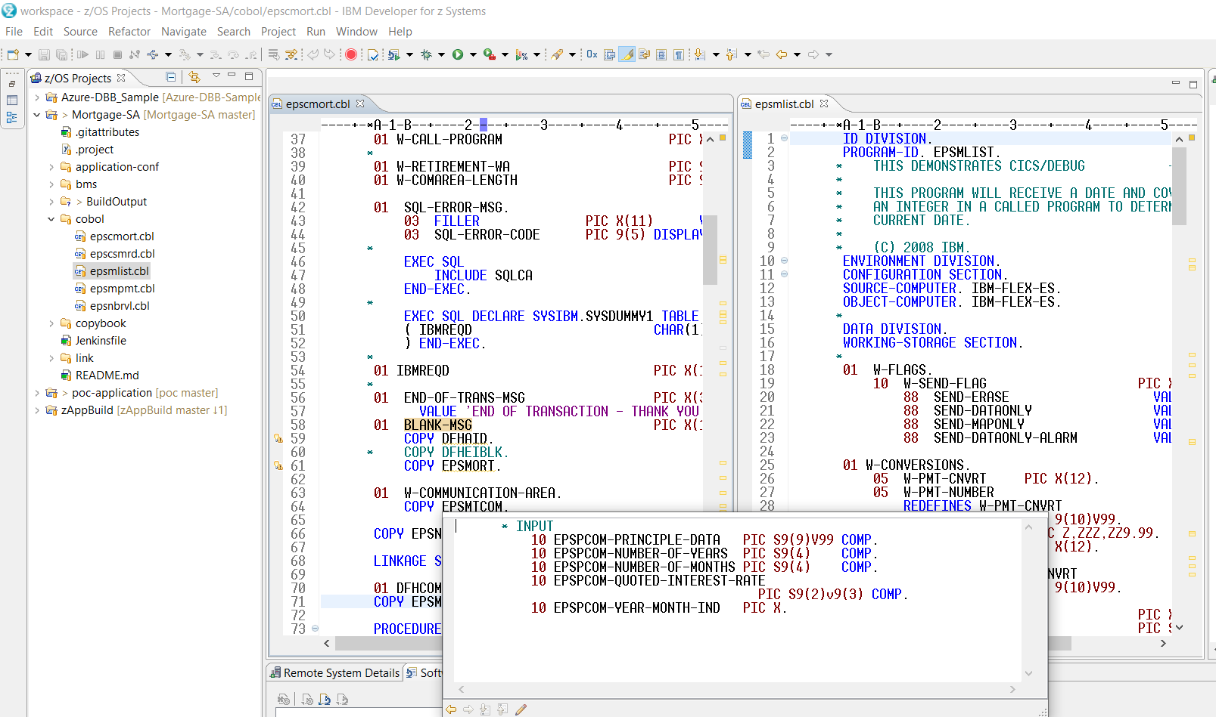
A day in the life of a Developer
DBB Build
Test
Branch
Repeat
Clone
Notes:
Related to slide 5

Slide 23
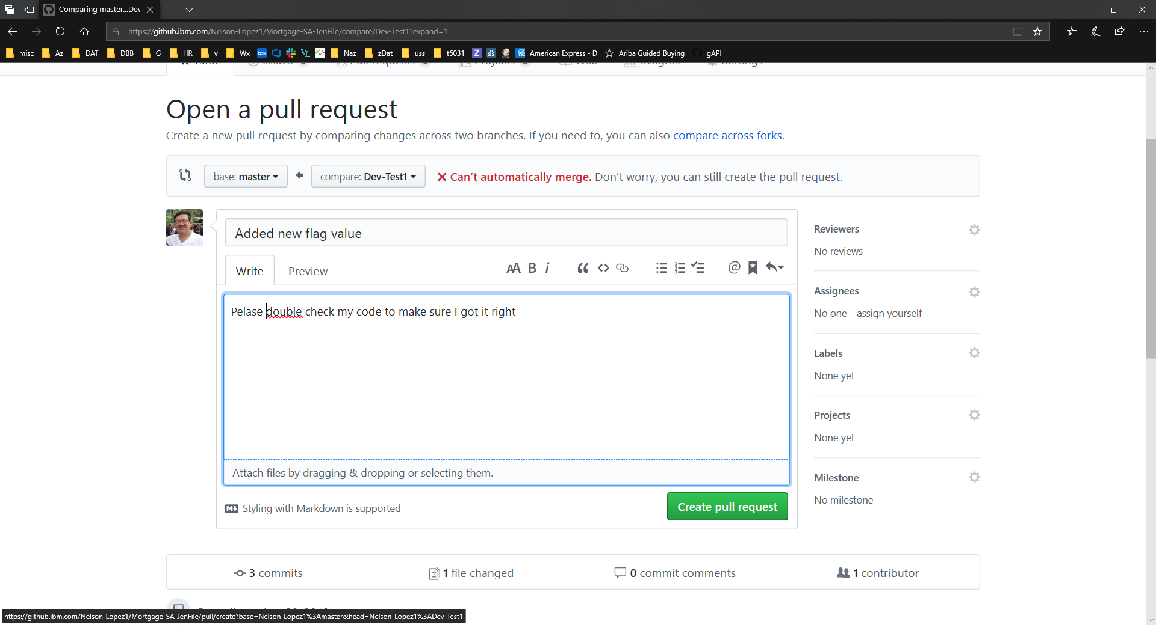
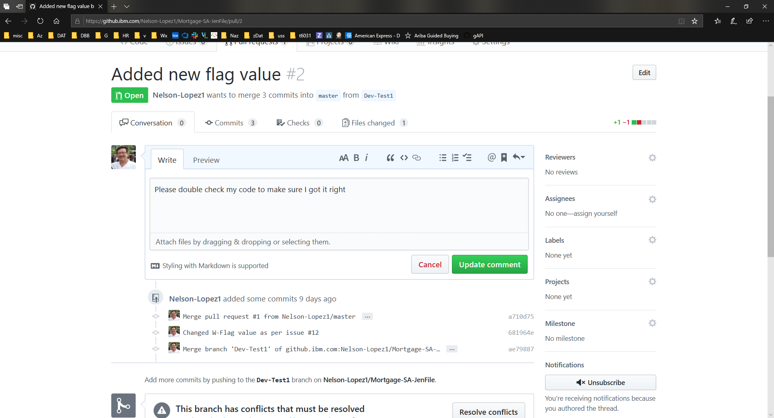
Pull Request
“Don’t Break the Build”
Pipeline Build
Quality gates
Peer Review
Approve and Merge
Open Pull Request

Slide 24
Deployment

Slide 25
CD Phase
Notes:
What we want to do is provide this pipeline as the automation framework for the DevOps transformation

Slide 26

DBB/UCD – Build, Package, Release, Deploy
GIT
Urban Code Deploy
DBB
Build.groovy
Build
UCD Code Station
Component Versions
BuildReport.json
TARFILE
TARFILE
DBB
deploy.groovy
Package
TARFILE
TARFILE
Deploy
artifacts
TARFILE
TARFILE
artifacts
myapp.tar
artifacts
Load1, dbrm…
Shiplist.xml
BuzTool
Release
$LPAR=xyz
CICS – COPY LOAD
BATCH/CICS – COPY LOAD
DB2 BIND DBRM
NEWCOPY …
Continuous Integration
Continuous Deployment

Slide 27
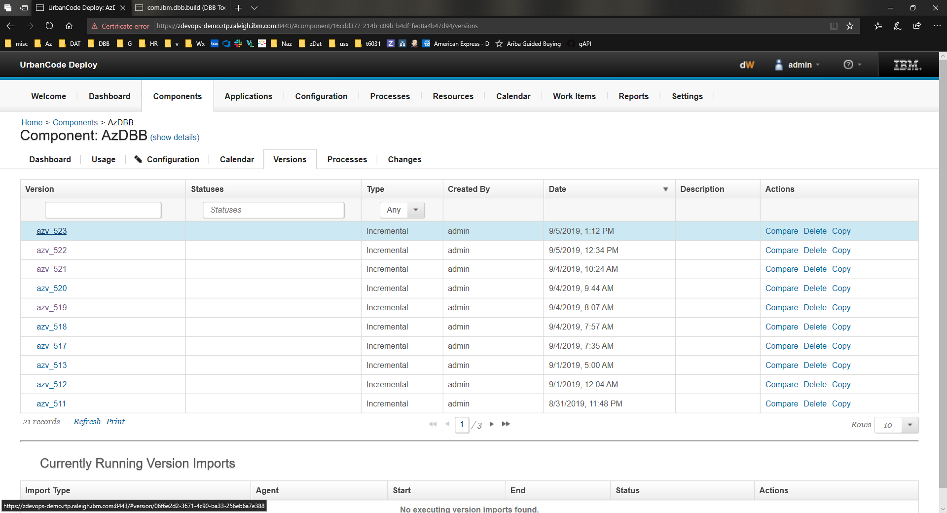
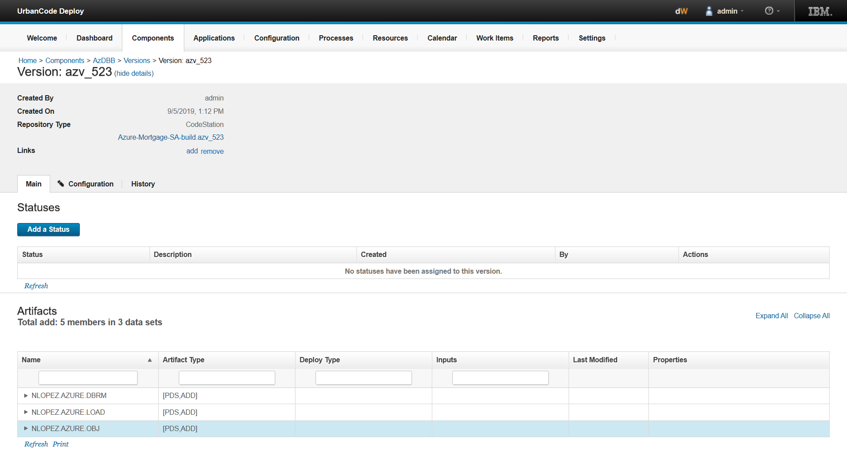
Urban Code Deploy
Artifact Store – Code Station
Link to trace back to DBB Build Report for this release

Slide 28
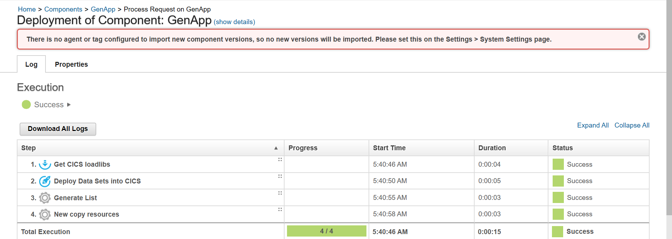
Deployment details

Slide 29
Getting started - IBMS DevOps Acceleration Team (DAT)
Adoption (DAT)
Design and Discovery
Install and Configure
Migration
Build basic workflows
Value Stream Assessment (SWAT)
Training
Deployment (DPO)
emphasis to-date
Key phases of the transformation process
Notes:
Value Stream Assessment – Executed by SWAT team, offering DevOps VSA Engagement, CI/CD Pipeline Mapping, POV Presentations
Training – Covering Idz, ADDI and CI/CD, it is delivering through Z DevOps Learning team as both instructor led Virtual training and online Self paced training
Deployment – Delivered through Deployment project office , offers upto 52 hours of remote assistance to help deploy IDz and ADDI as per best practices
Adoption – Delivered through DevOps Acceleration Team, the team will start with capturing your current state and based on requirements design your future state. Help with preparing scripts and deploy the future state solution and CI/CD workflow.

Slide 30
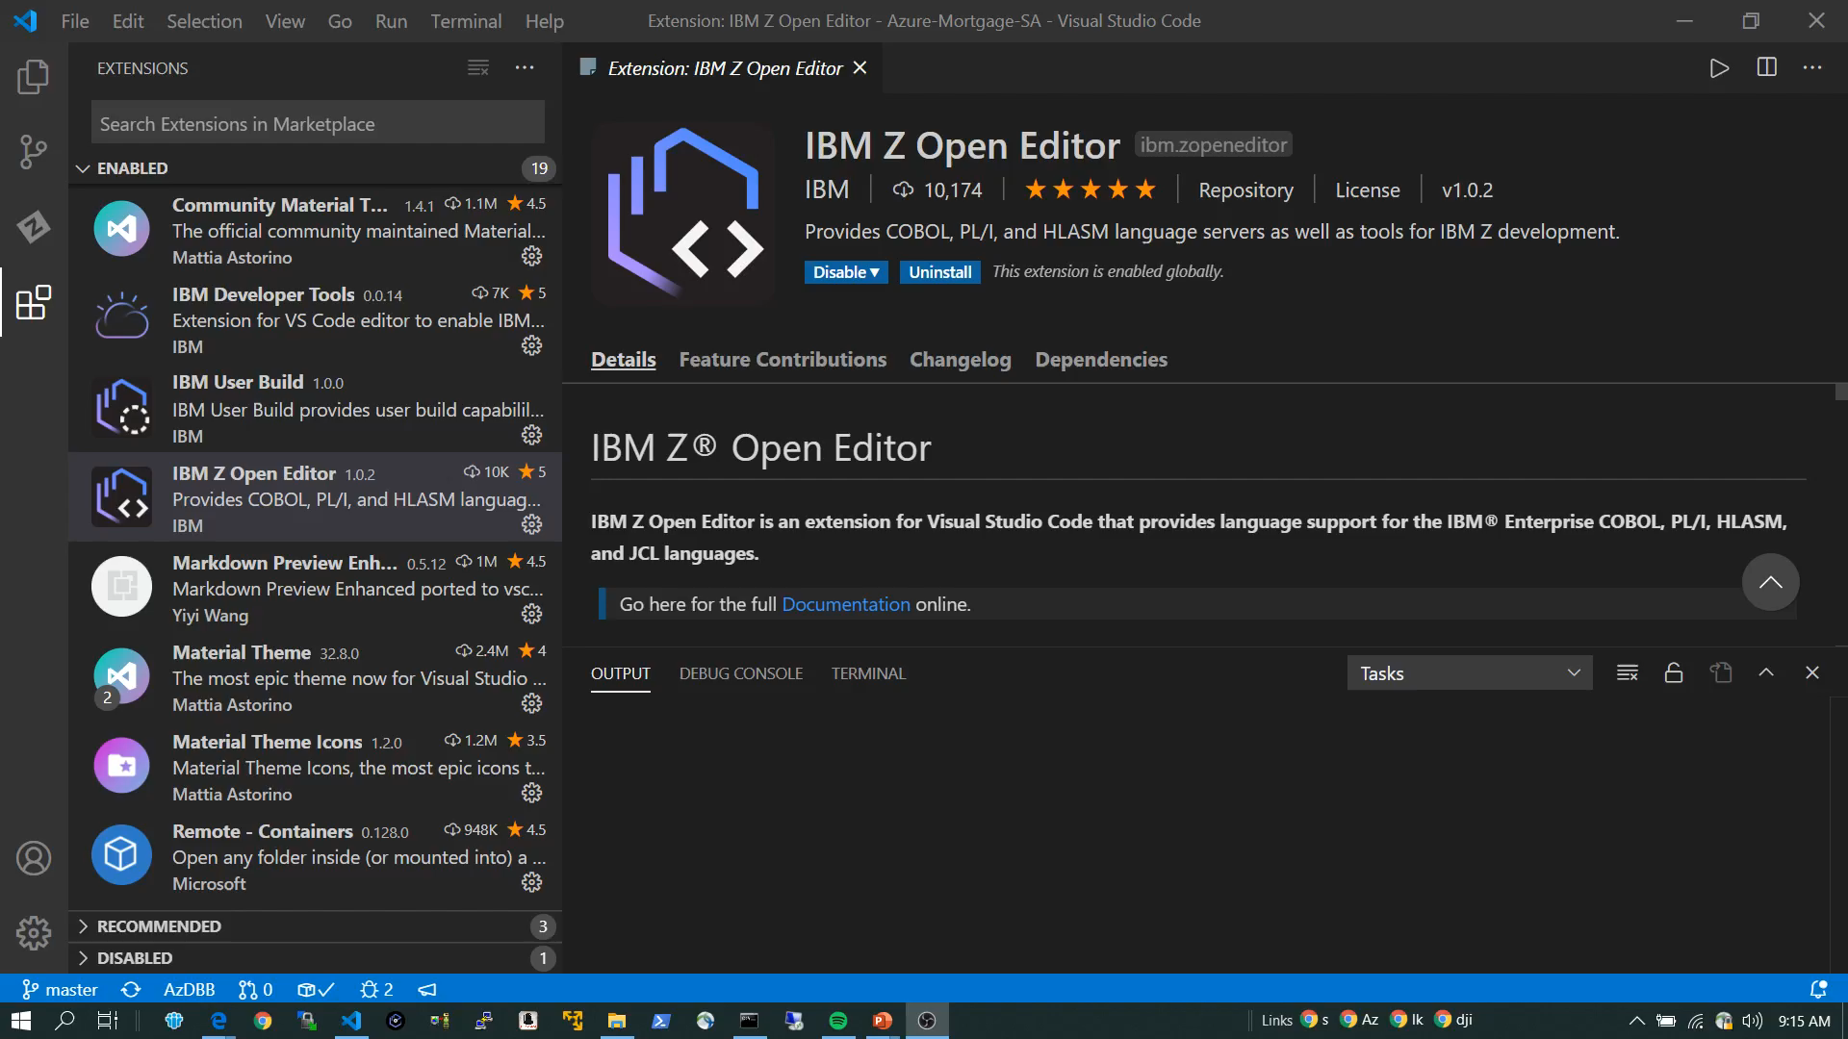
Click for a short demo
The End
Notes:
Run the demo (duration mins 5:23 )
Vs Code with IBM Open Editor and the new Zowe plugin to Z
Azure DevOps repo and pipeline with DBB and UCD

Slide 31
Thank You

Slide 32



From CI to CD
GIT – Branching Model
Pipeline
CI
CD
M
M+1
Merge/rebase - Master
Prod M+1
Sprint
R+1
Release – Final Build
QA/UAT
R+1
D
PR – Integration Build
Team
F
F
User Feature build
User
F
BUILD
DEPLOY
RUN
M=Master, D=Develop, F=Feature, R=Release, +1 is a new tag version, Long Lived Branch

Slide 33

DBB/Artifactory - Build, Package, Release, Deploy
GIT
DBB
Build
$LPAR=xyz
CICS – COPY LOAD
BATCH/NCAL – COPY LOAD
DB2 BIND DBRM
NEWCOPY
TARFILE
TARFILE
BuildReport.json
TARFILE
Package.groovy
TARFILE
TARFILE
artifacts
TARFILE
TARFILE
Artifacts
Publish.groovy
Pull.groovy
release
App.yaml
TARFILE
CicsDeployUtilities.groovy
Deploy
Application-conf/
deploy.$lpar.yaml

Slide 34
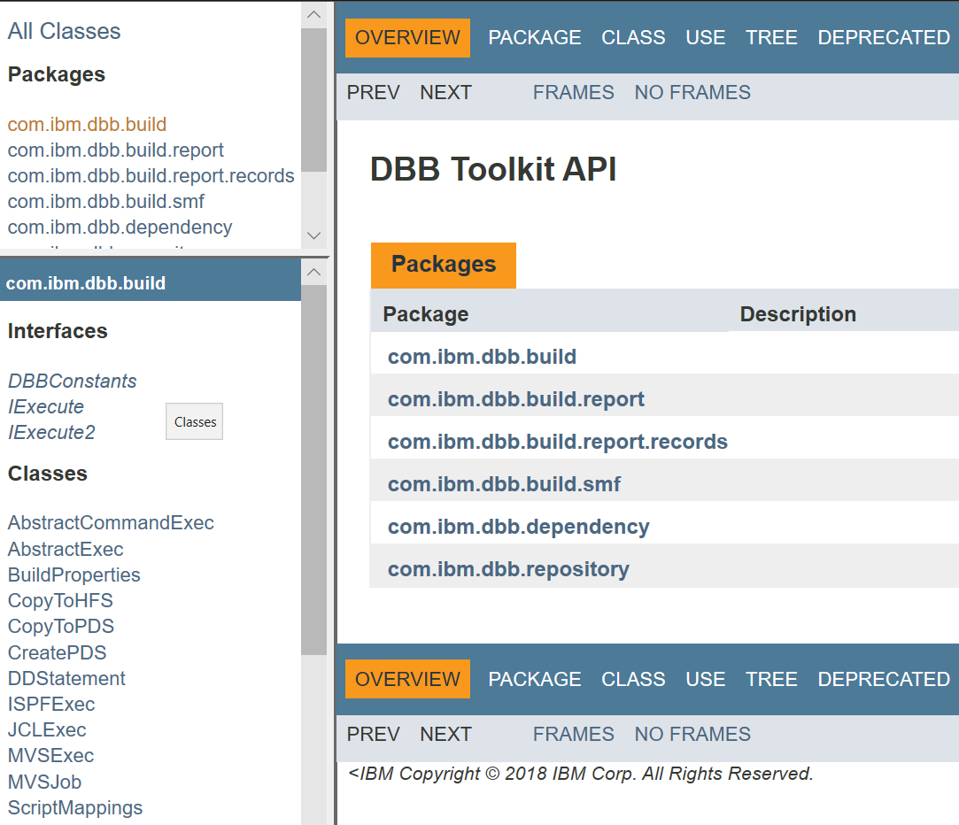
DBB Java API Toolkit
A set of Java APIs used to define scripts that:
Run MVS programs, TSO/ISPF commands, Submit JCL
Scan, store and retrieve application dependency metadata
Utilities to copy to/from PDS’s and USS zFS
Migrate source from PDS’s to Git

Slide 35
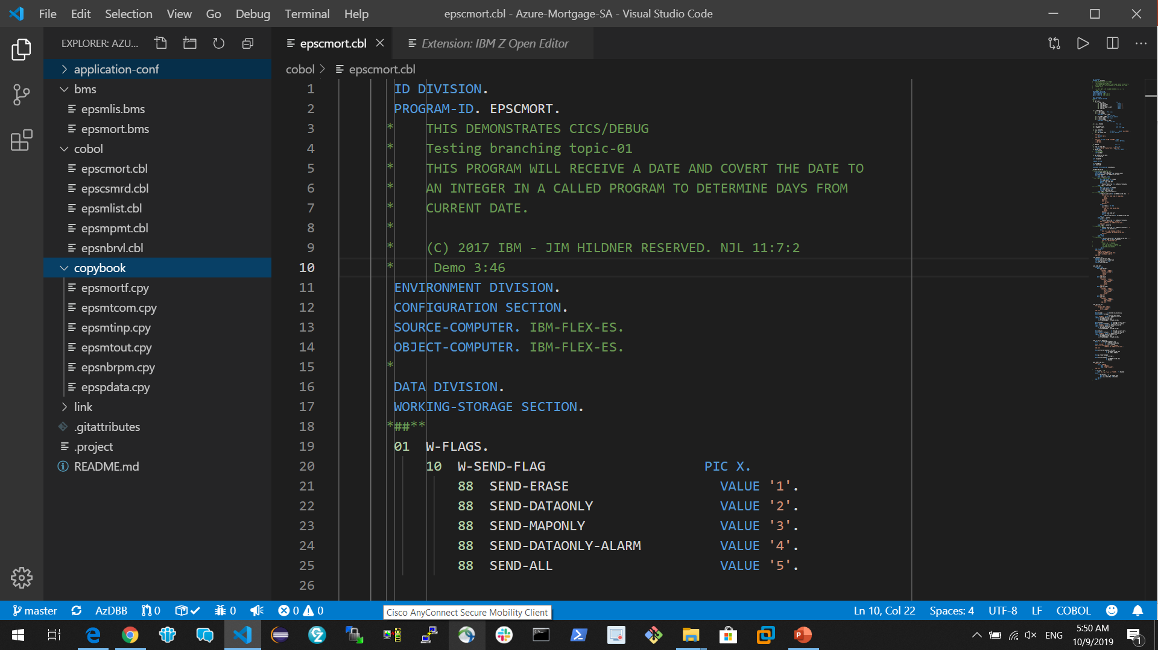
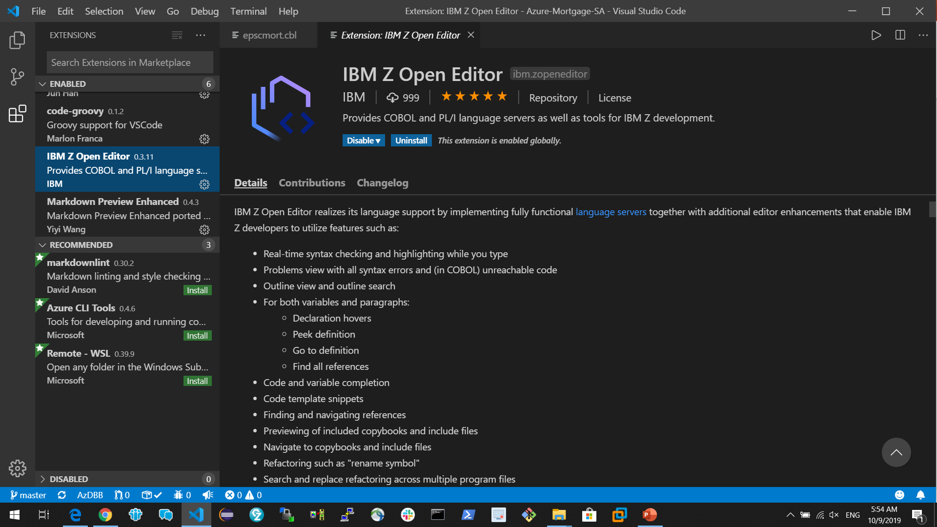
VS Code with IBM Z Open Editor

